Slide 1


Slide 2
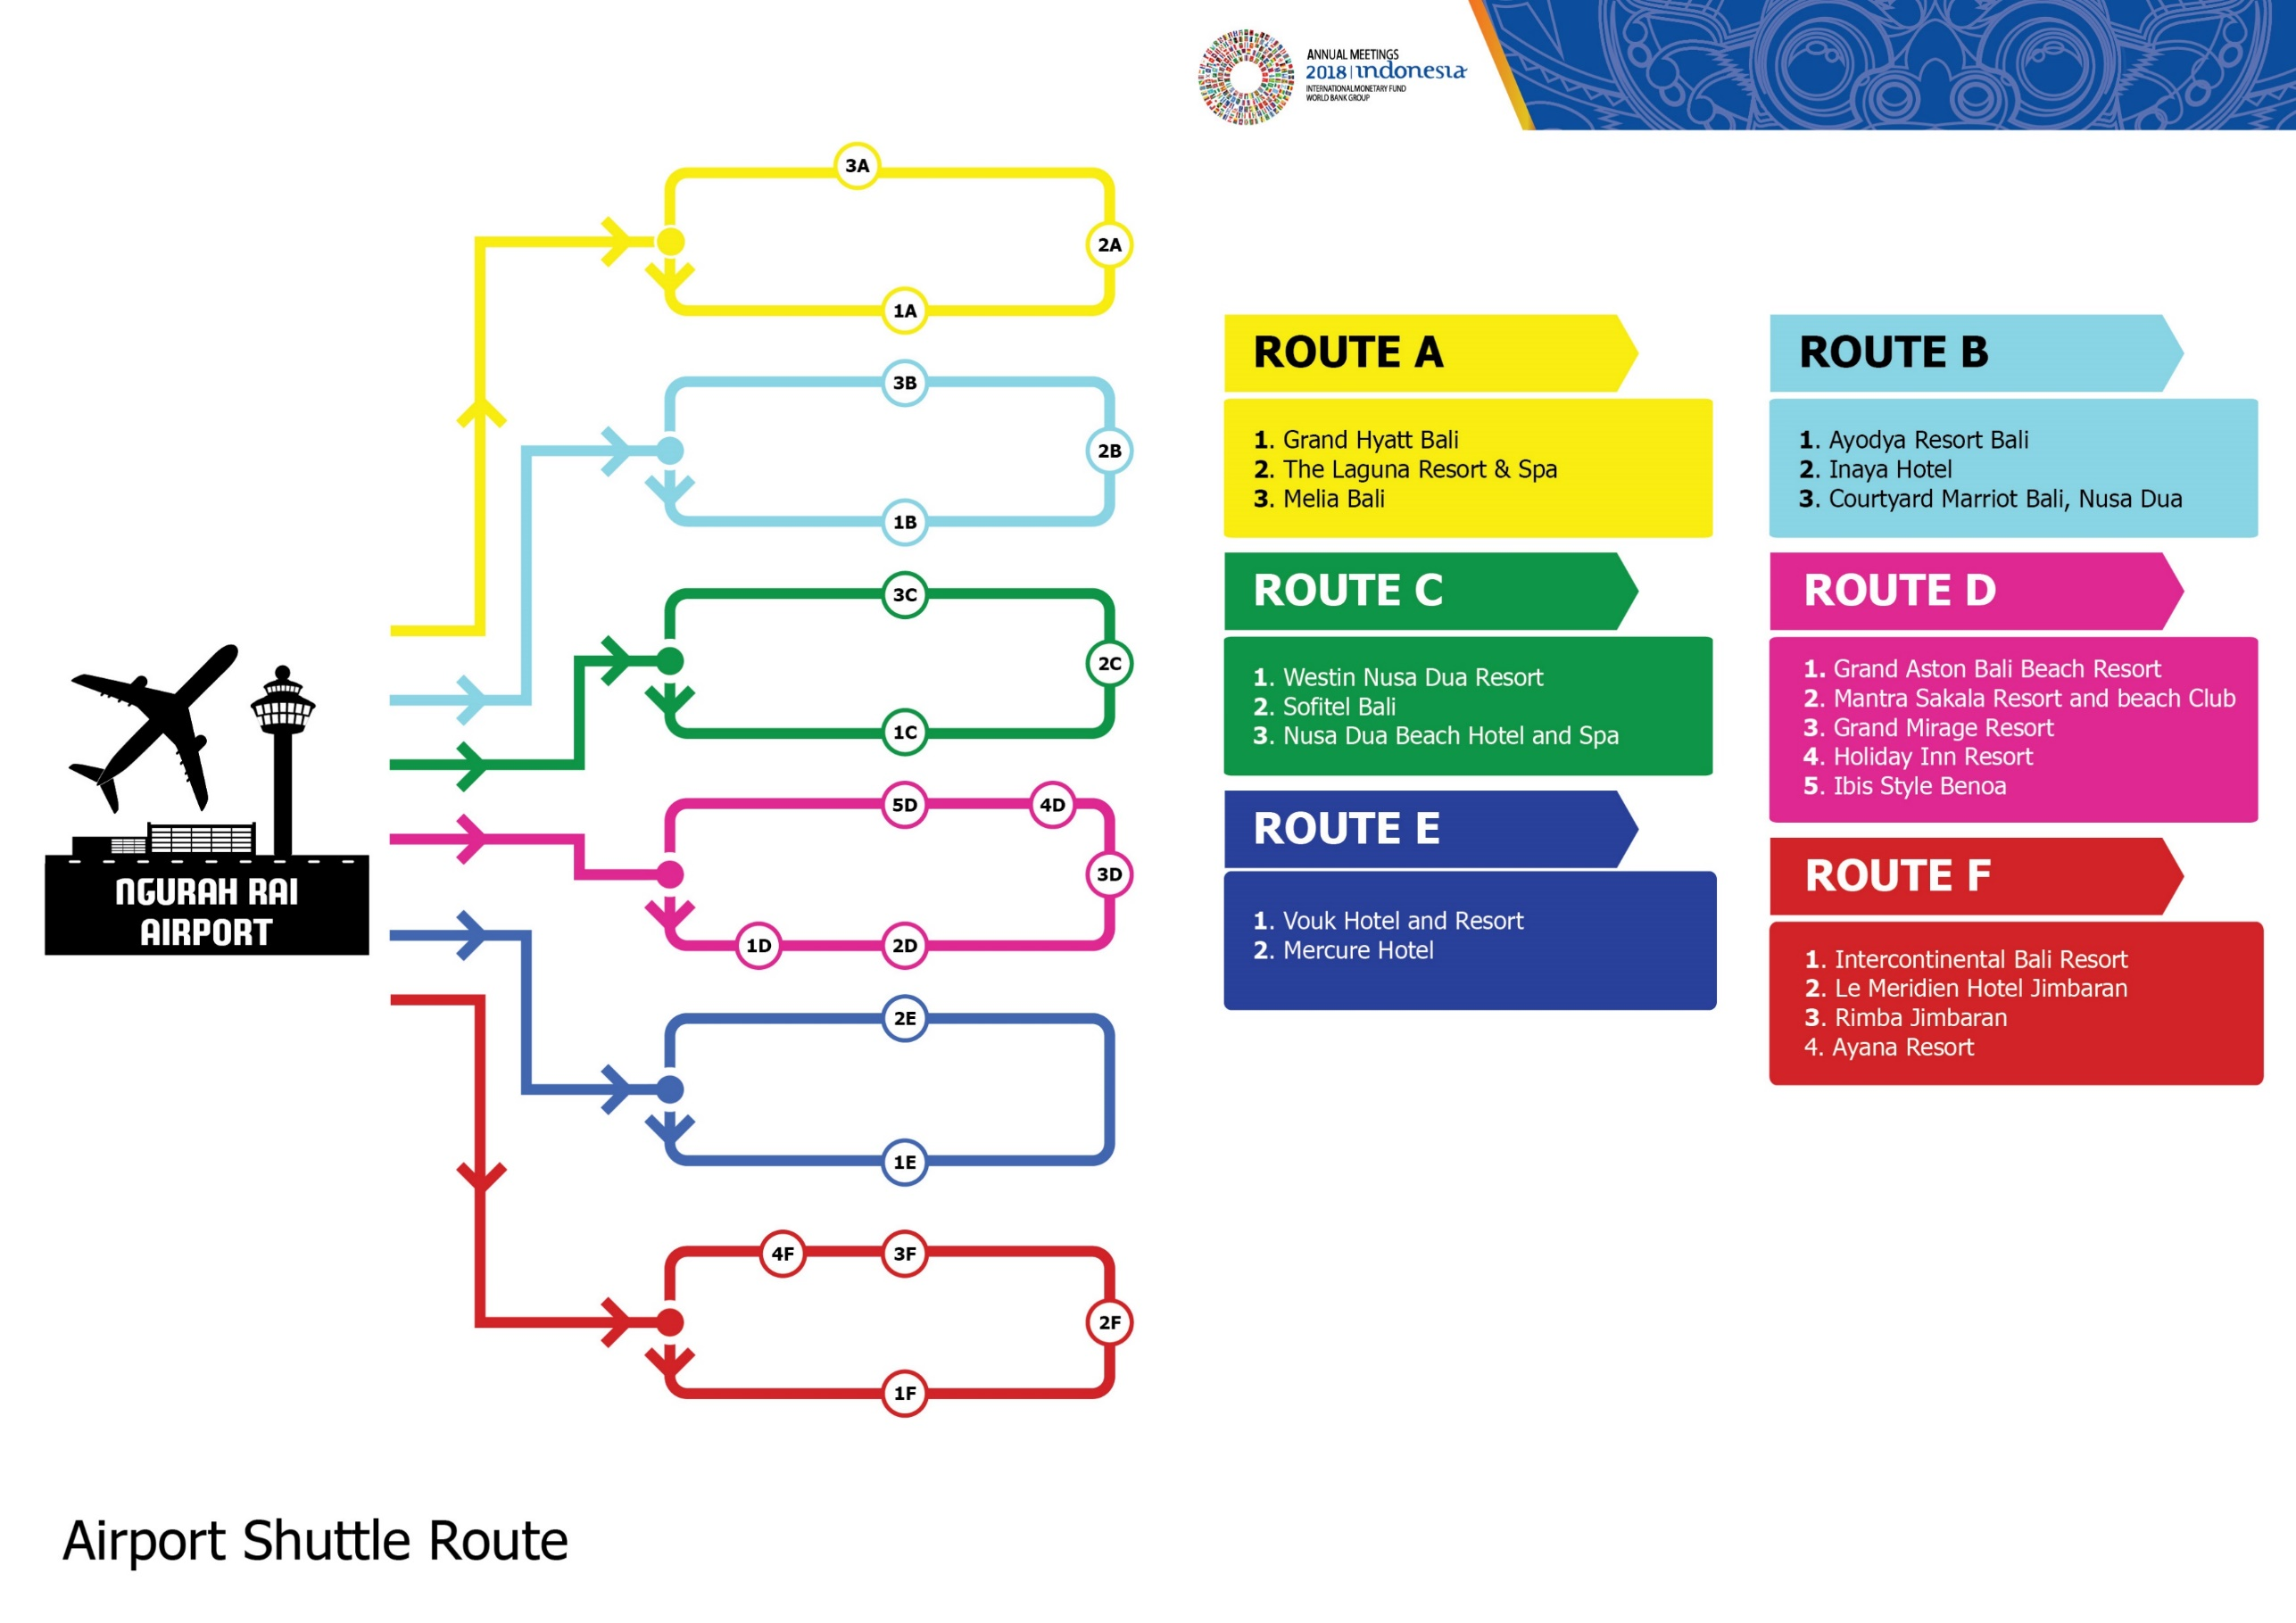
Airport Shuttle Route

Slide 3
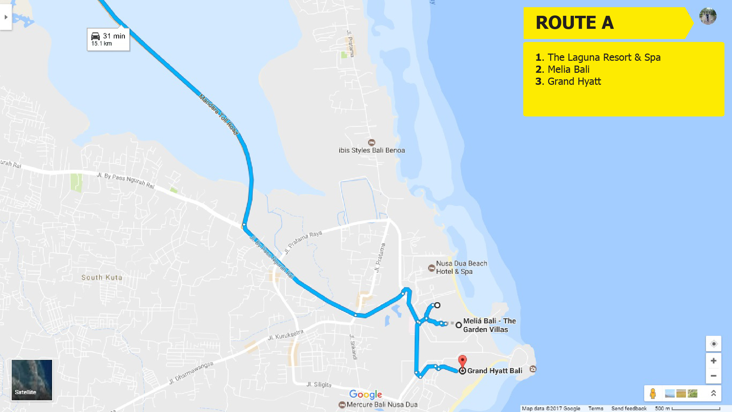

Slide 4
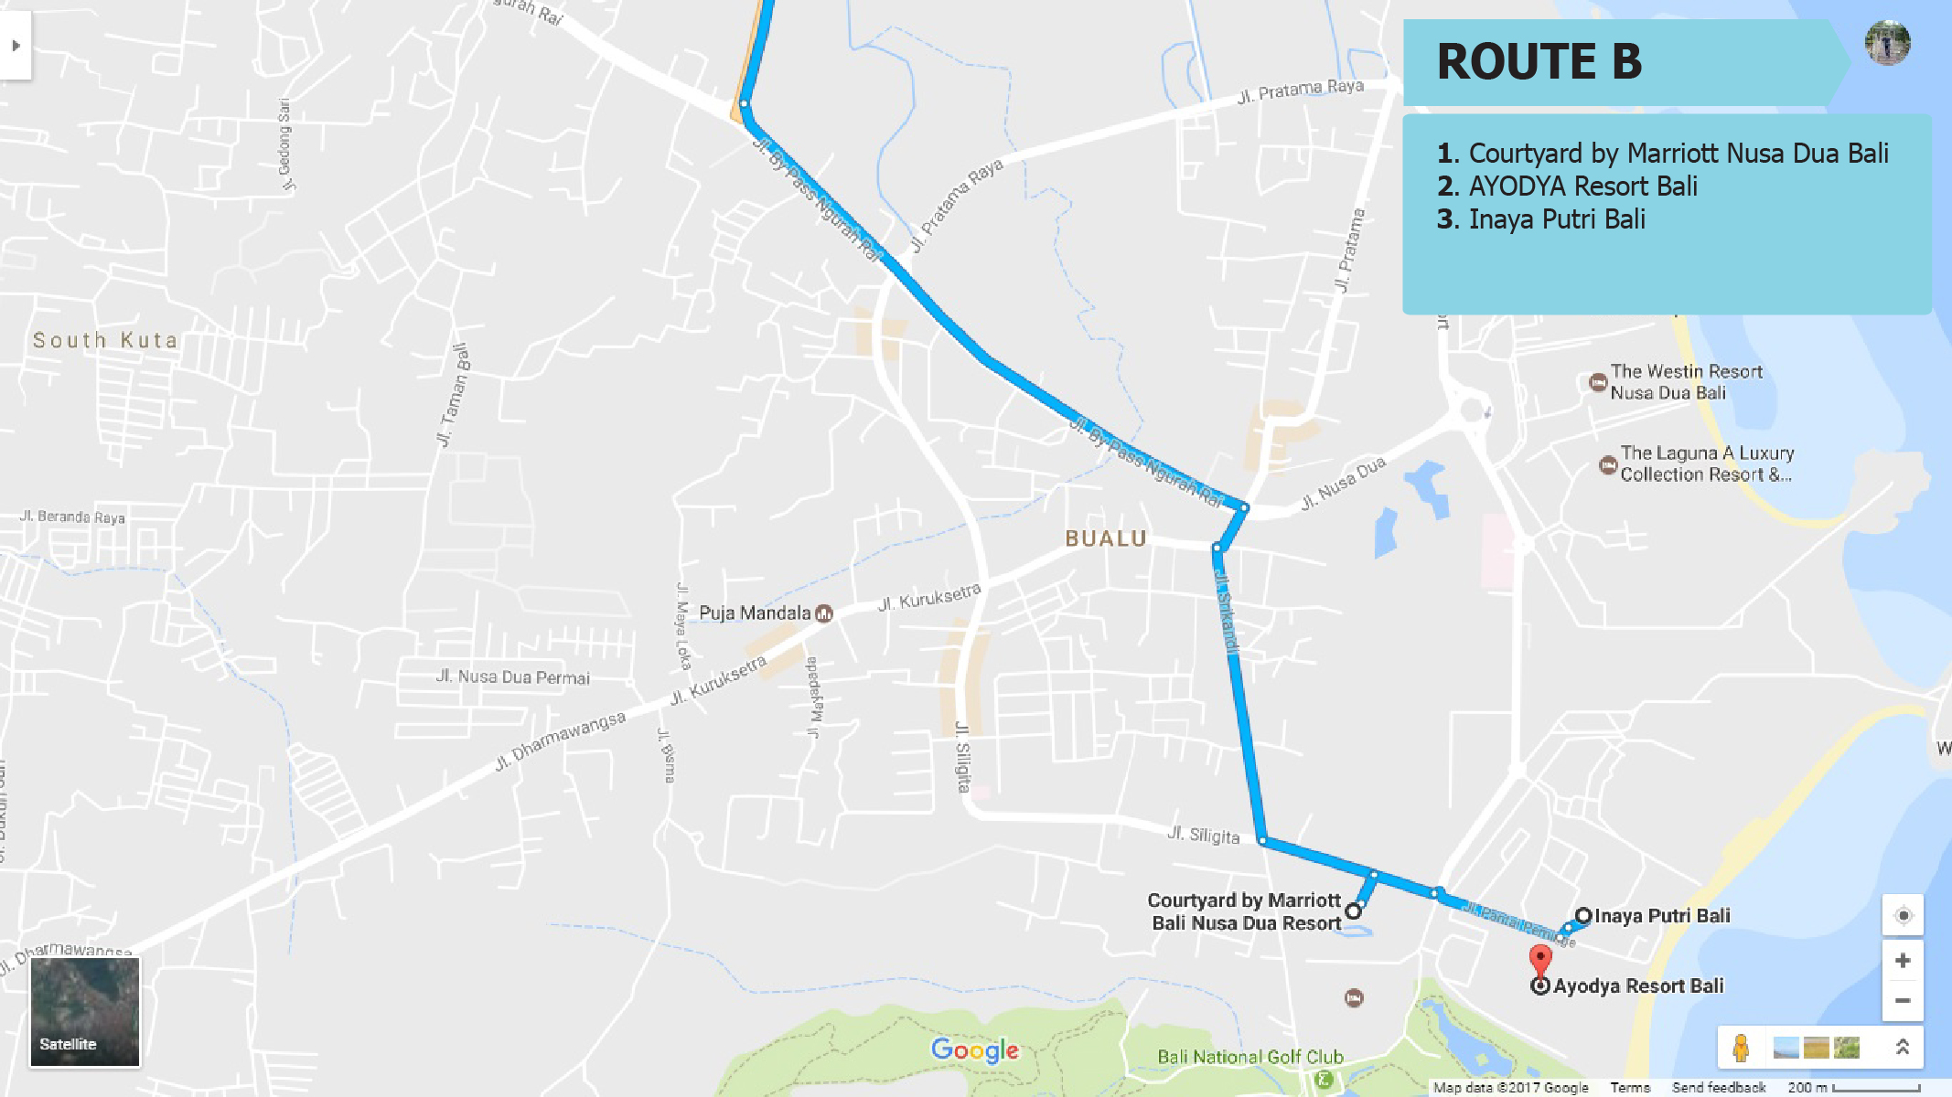

Slide 5
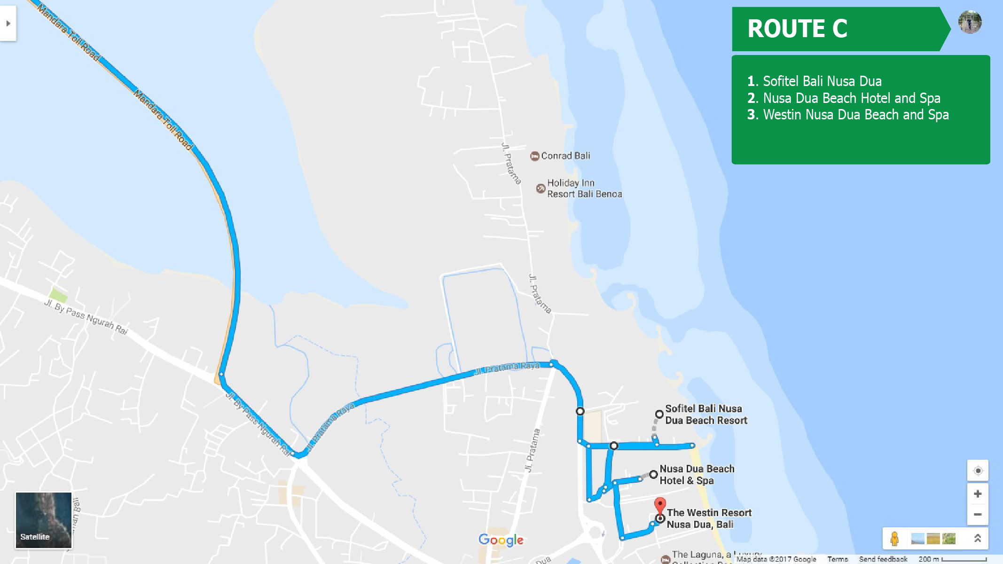

Slide 6
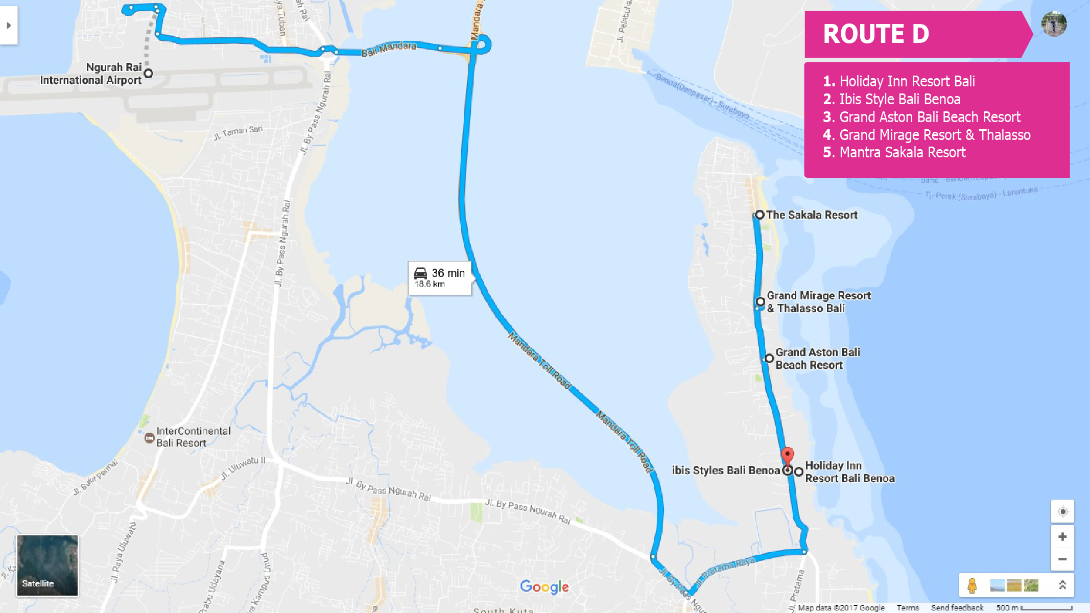

Slide 7
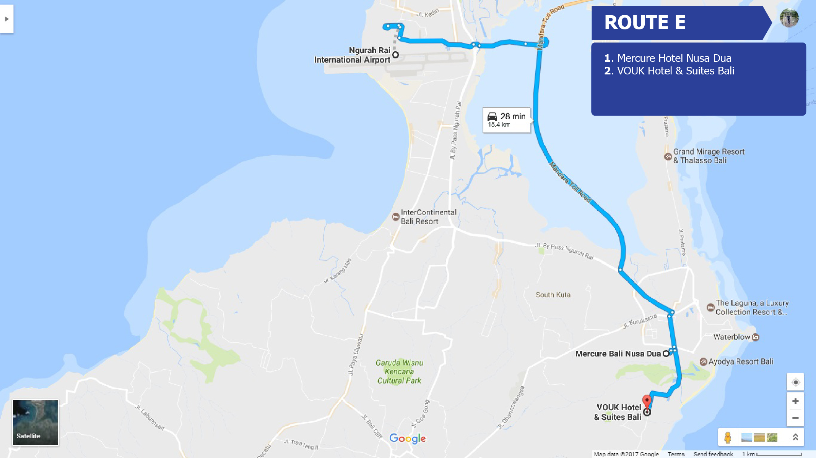

Slide 8
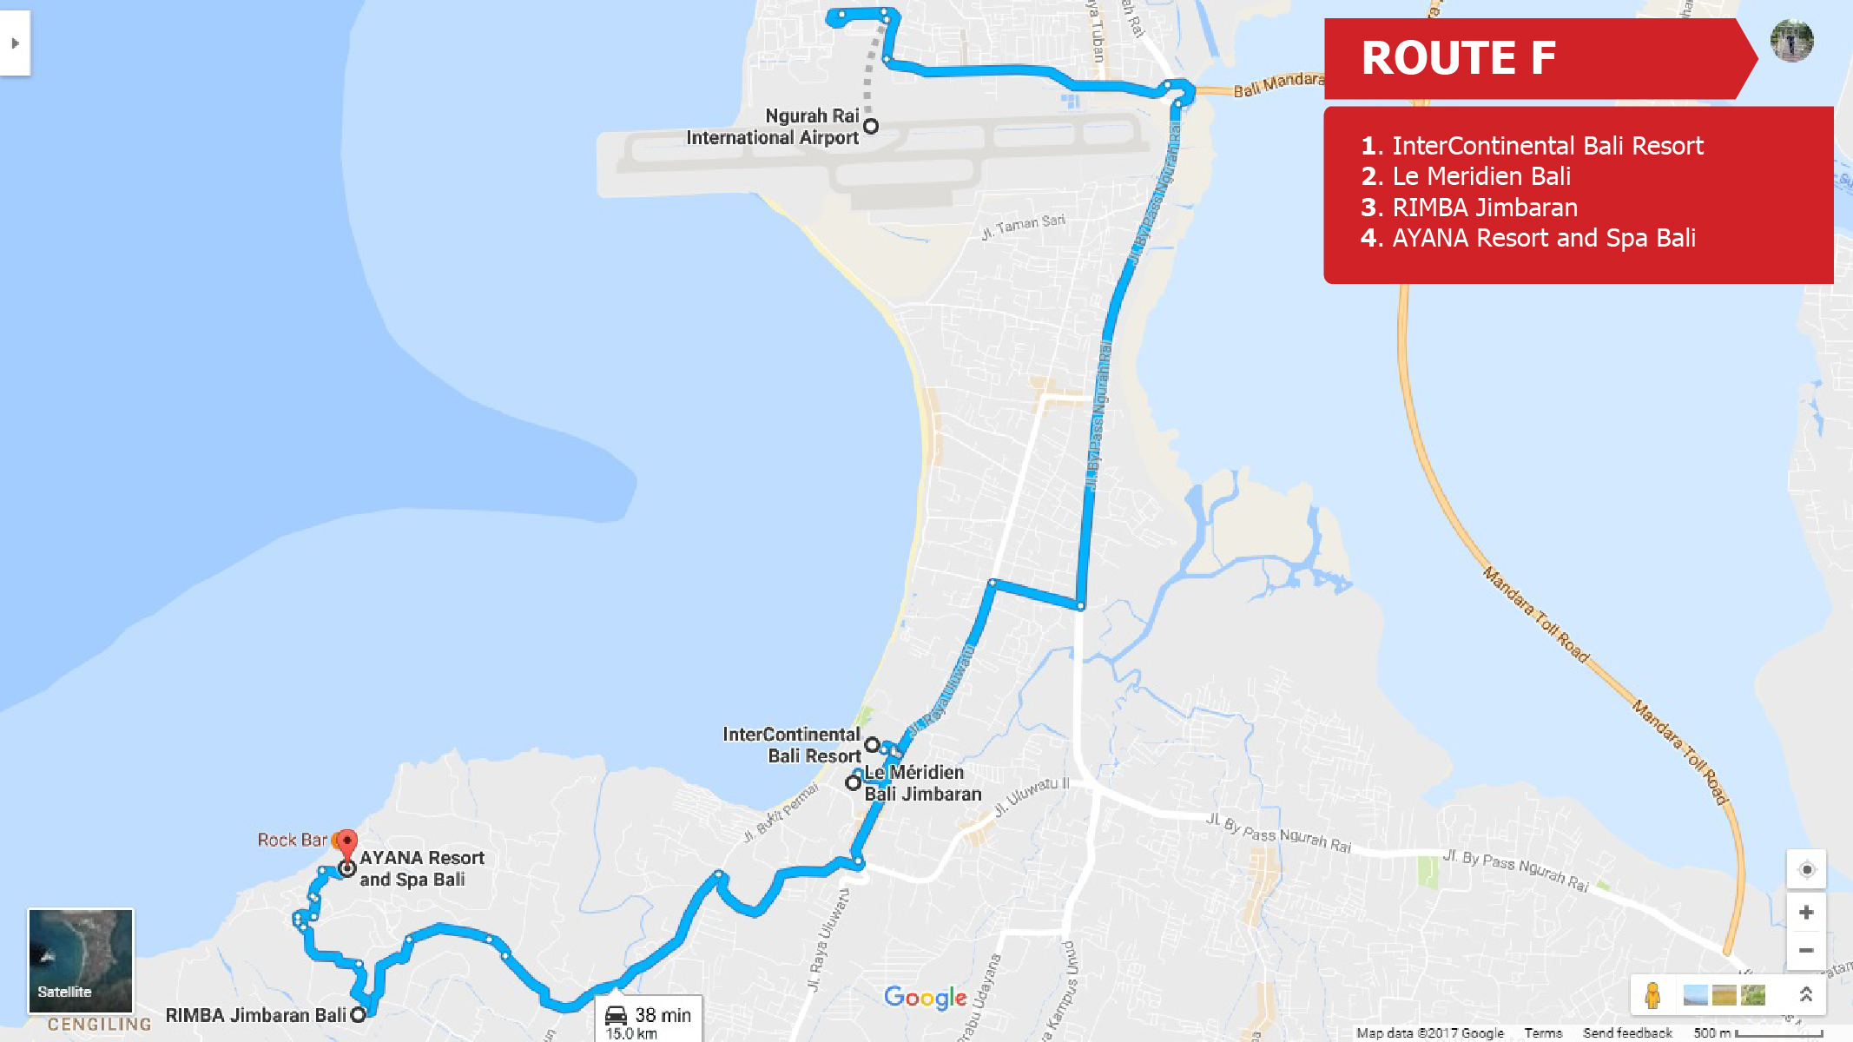

Slide 9
Official Hotels
Grand Hyatt
The Laguna resort and Spa
Melia Bali
Ayodya Resort Bali
Inaya Hotel
Courtyard Mariot Bali, Nusa Dua
Westin Resort Nusa Dua
Sofitel Bali
Nusa Dua Beach Hotel and Spa
Grand Aston Bali Beach Resort
Mantra Sakala Resort and Beach Club
Grand Mirage resort
Holliday Inn Resort Bali Benoa
Ibis Style Benoa
Vouk Hotel and Resort
Mercure Hotel
Intercontinental Bali Resort
Ayana Resort
Le Meridien Hotel Jimbaran
Rimba Jimbaran
Laguna Resort and Spa

Slide 10
Official Venues and Office
Bali Nusa Dua Convention Center (BNDCC)
Bali International Convention center (BICC)
Westin Resort Nusa Dua Bali
Grand Whiz Hotel

Slide 11
Registration
Nusa Dua Beach Hotel

Slide 12
Information about each Hotel
Hotel name :
Number of Rooms:
Distance from
Venue (BNDCC and BICC)
- Airport
No Of Restaurants :

Slide 13
Information about each Venue
Venue name(BICC and BNDCC) :
No Of Meeting rooms :
Utilizations :

Slide 14
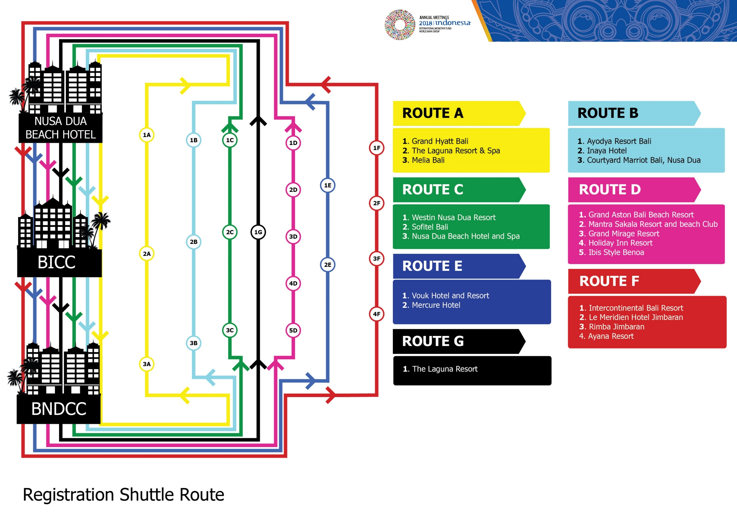

Slide 15
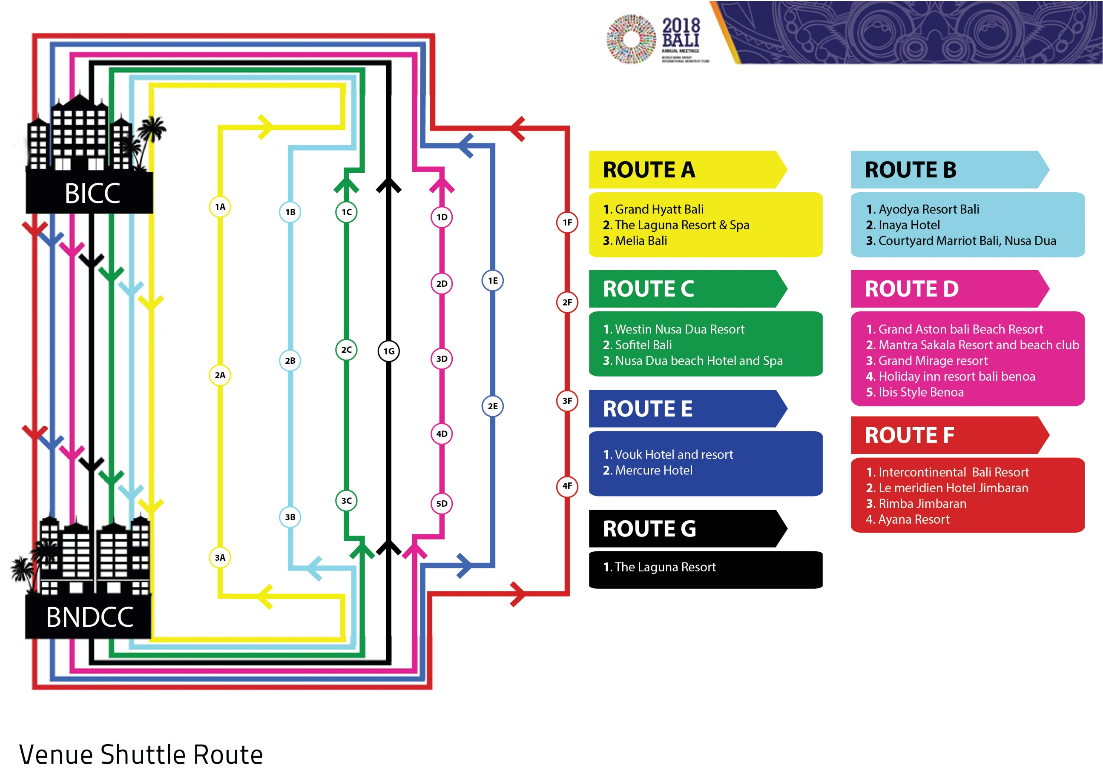

Slide 16
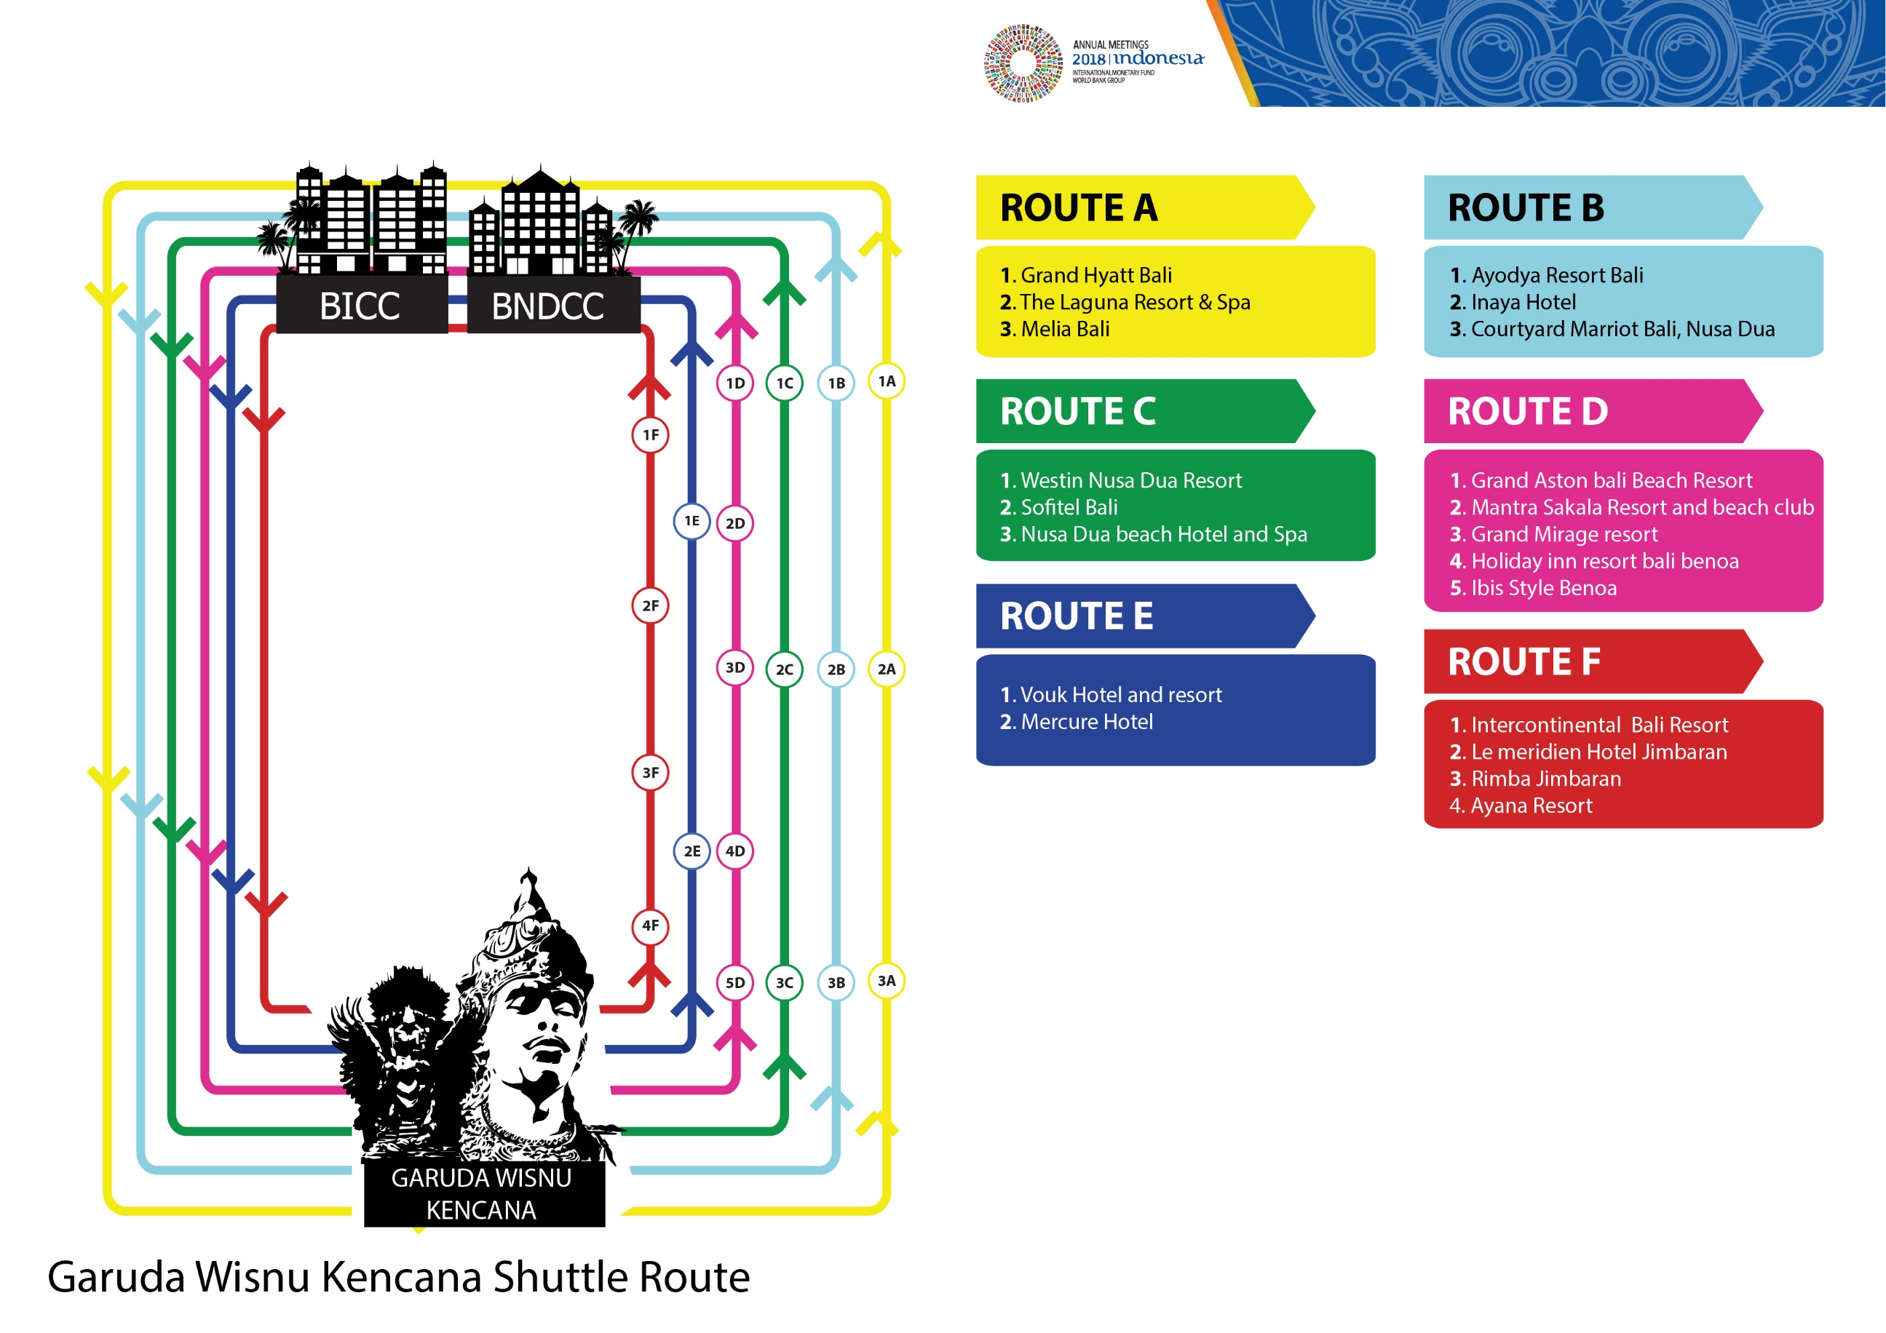

Slide 17
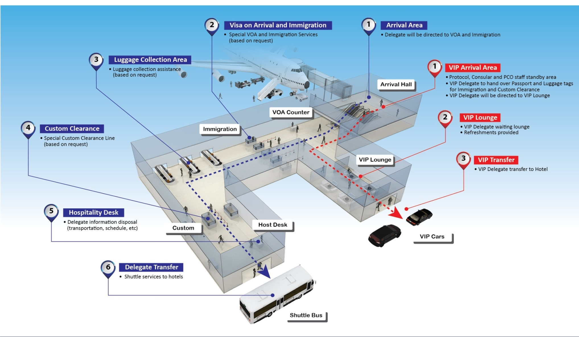
Arrival Flow

Slide 18
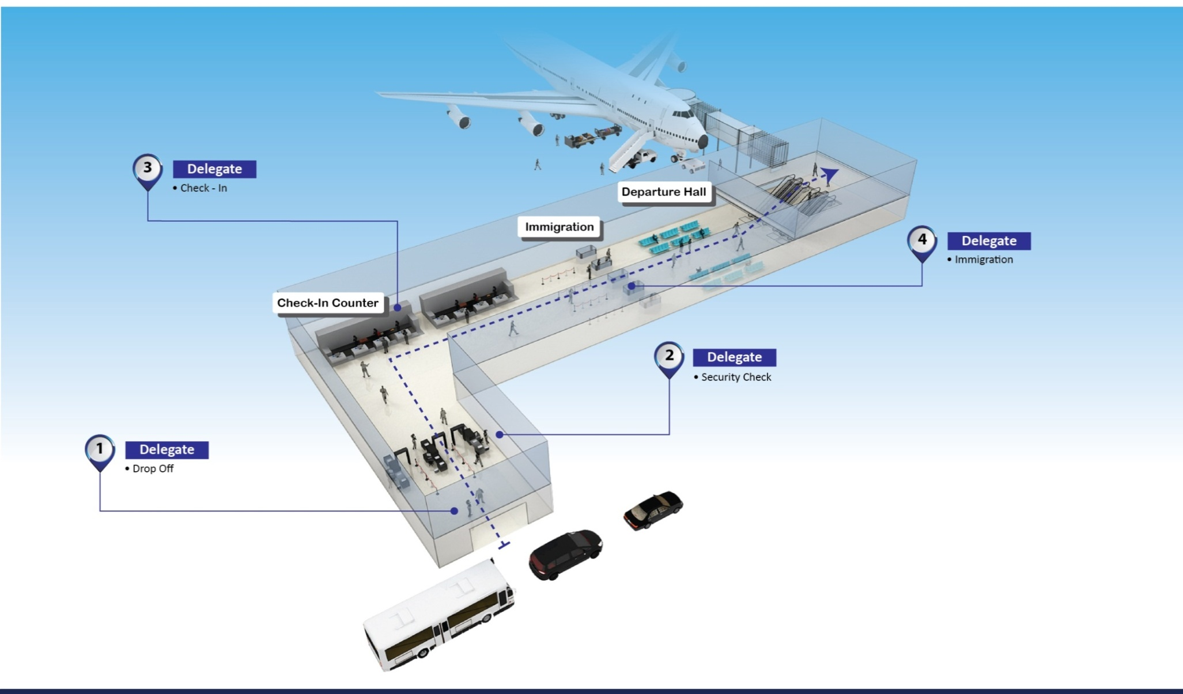
Departure Flow

Slide 19
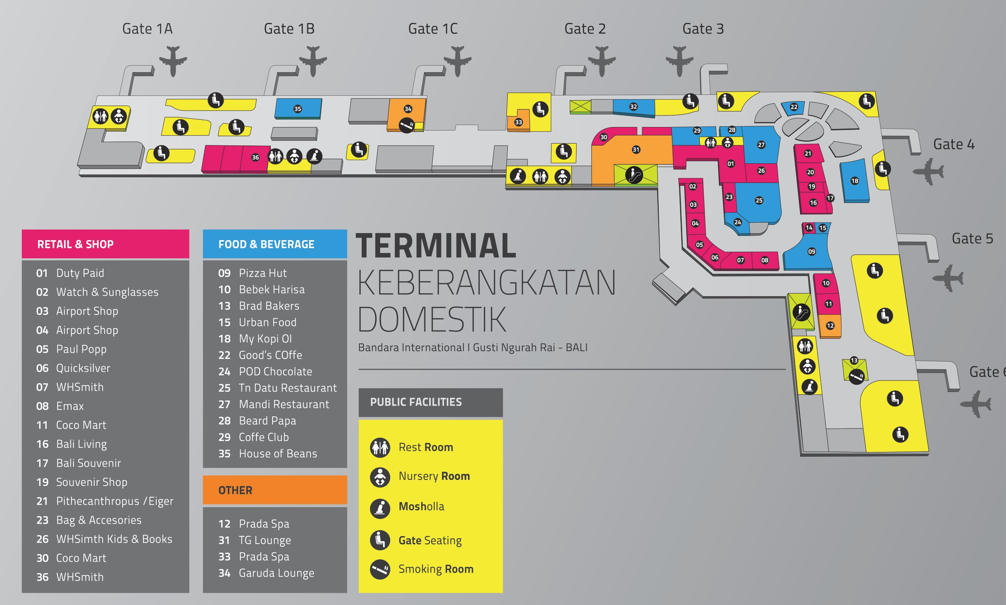
Ngurah Rai Domestic Terminal

Slide 20
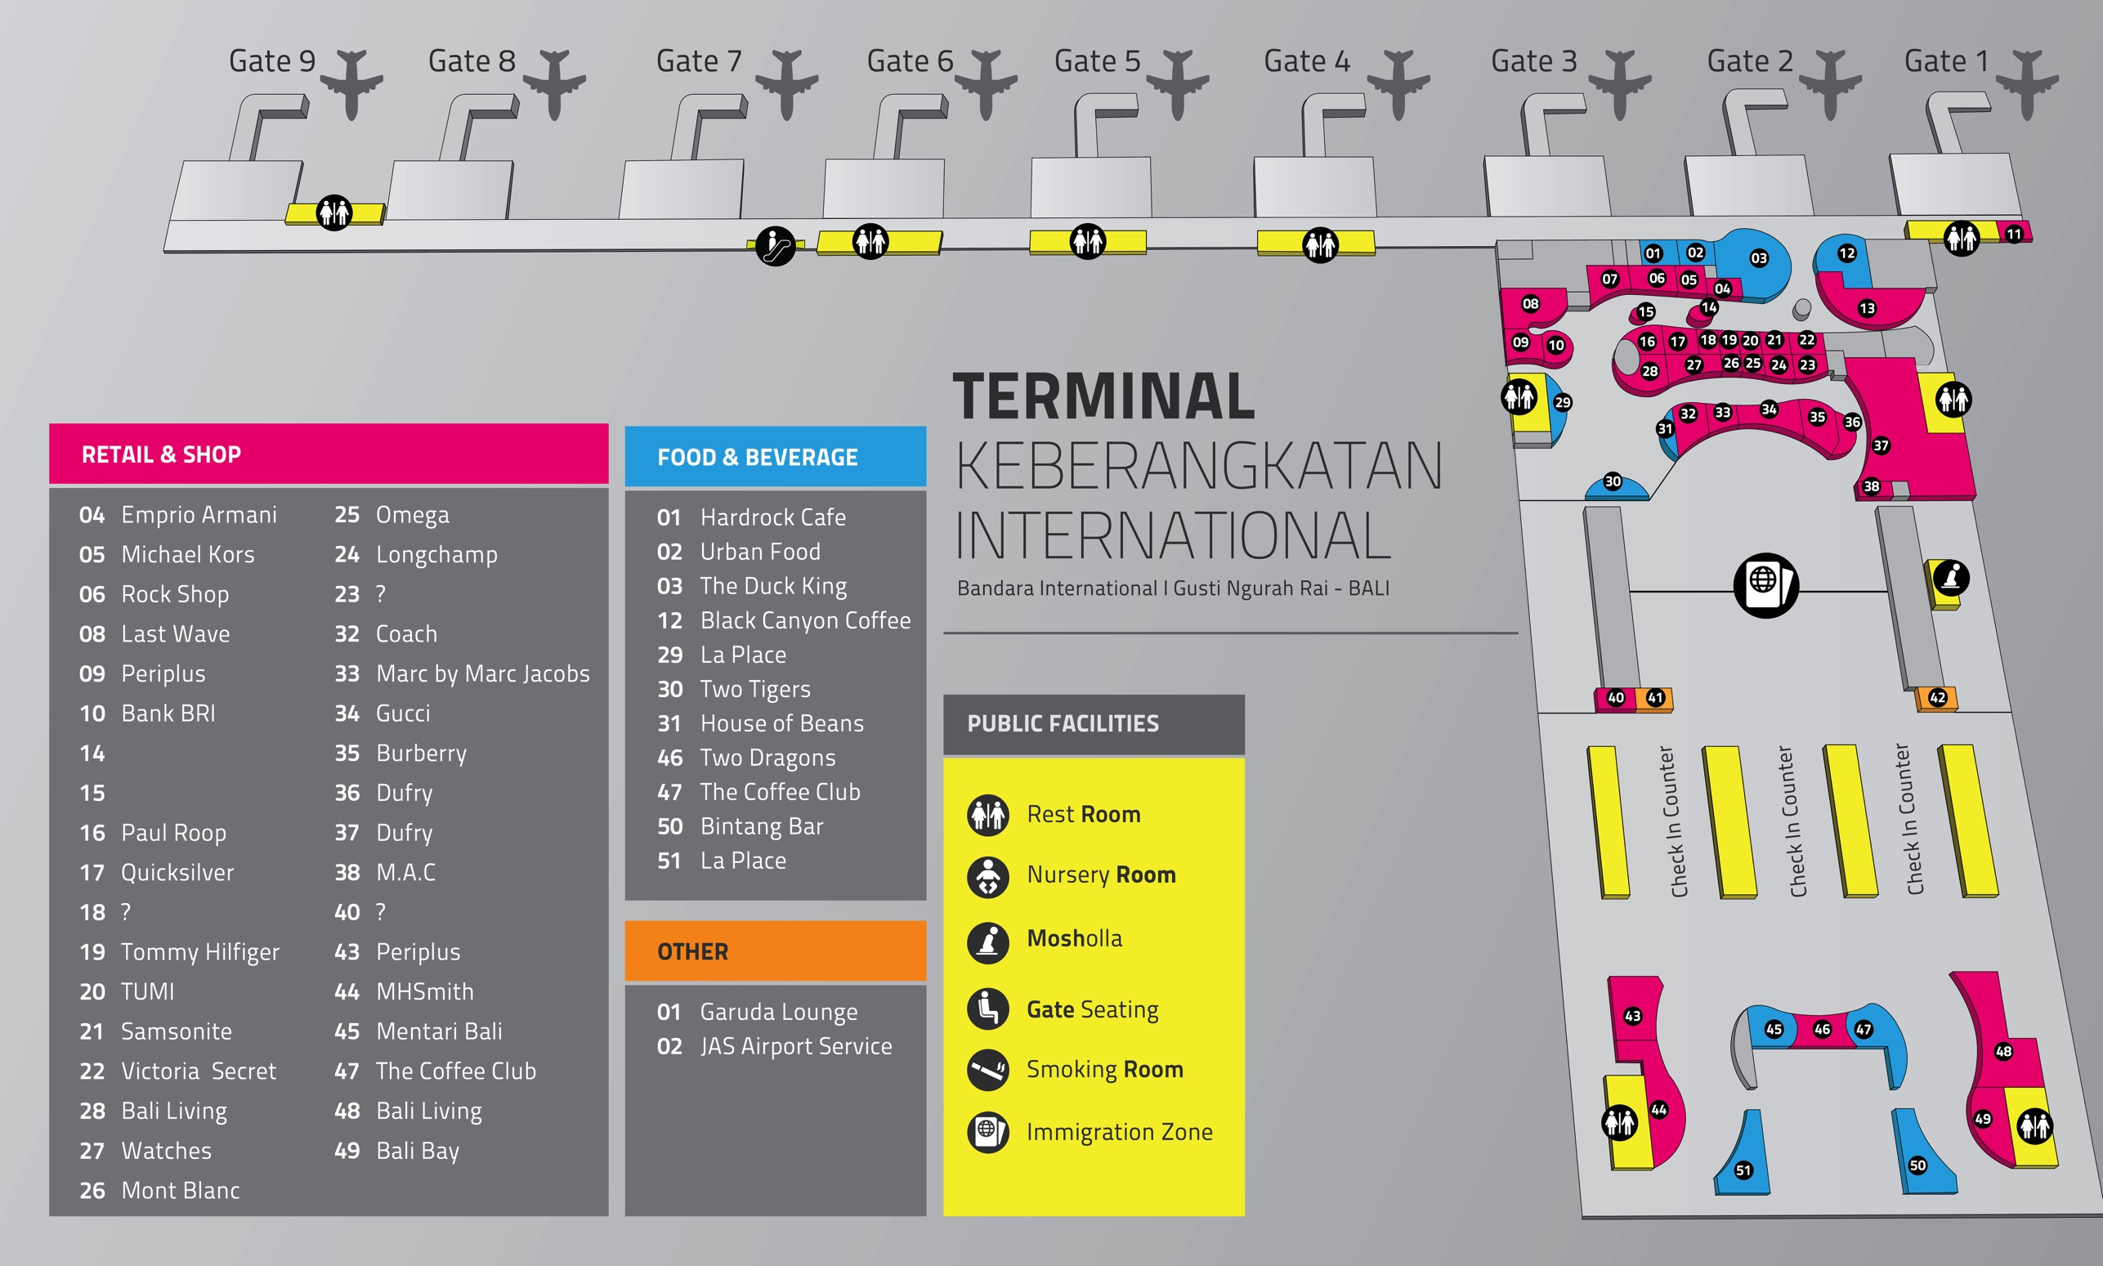
Ngurah Rai International Terminal

